Slide 1
SAFETY AND FACILITIES PLANNING Scott Landrigan 04-09-18

Slide 2
Safety and Security
Program Development
Policies and Procedures 3432, 3432P
District Emergency Operations Plan (EOP)
School Emergency Response Plan (ERP)
Recent Improvements Overview
Future Improvements Strategies/Lessons Learned

Slide 3
Requirements
OSPI
School Level
Plans
NFPA
FEMA
WPS ERP
OSHA
3432
Policy
3432
Procedure
(District) Emergency Operations Plan
WIS ERP
SAFE SCHOOLS
WMS ERP
RCW’s
WHS ERP
WAC’s
Program Architecture
Yale ERP
Rapid Responder
ESD 112
HE Safety Plan

Slide 4
Policy and Procedure 3432
Key Points
Provides Legal and Regulatory Requirements for School Emergency planning
Standardizes Emergency Planning Activities Across the District
Incident Command System deployment and training and responsibilities
Reunification planning, deployment and MOUs
Staff Training of building emergency systems (JSA’s)
Drill scheduling and critiquing
Campus Security and access
Development of emergency response plans
Identification of District responsibilities
Implementation of Standard Response Protocol (SRP)
Police and fire collaboration
Communication
Visitor to the District
Educational continuity
Special needs students
Utility isolation and HMIS maps
Contents of the District and school level plans
Hazardous material storage and utility isolations
Probability Modeling

Slide 5
School Safety Probability Modeling Exercise
Establishes emergency procedures based on the uniqueness of each campus
A team of 5-6 at each campus created model for that school
31 emergencies evaluated in four categories
Natural – Earthquake, flood, tsunami's, volcanic activity
Man-made – Train derailment, toxic gas, dam failure
Infectious diseases – Pandemic, influenza, tuberculosis, meningitis
Adversarial- Gang activity, gun violence, kidnapping, riots
Each emergency is graded by:
Probability – How likely is this event?
Magnitude – If it happened, what is the level of impact?
Warning – Would there be advanced warning?
Duration – How long would the event last?
Highest graded emergencies are part of the schools ERP

Slide 6
School Safety District-Emergency Operations Plan (EOP)
Provides District Level Support Documents and Procedures
Identifies/establishes requirements for school level plans
Appointment letter
District Procedure 3432P
Identifies SRP as the primary response program for Woodland Schools
Defines ICS roles and responsibility
Copy of Accident Prevention Program
Directs schools to perform Probability Modeling
Job Safety Analysis
Hazard Communication
Identifies drill schedules and critiques
MOU’s for reunification

Slide 7
School Safety School-Level Plans (ERP’s)
District Procedure
Standard Response Protocol
Standard Reunification Method
Emergency Response Plans (based on probability model exercise)
Utility isolation maps
Hazardous material maps
Student and staff list
First aid providers
Substitute reference sheet
Critical phone numbers
ICS duties and assignments

Slide 8
School Safety Recent improvements to school safety:
HVAC shutdown
CO detectors installed in all classrooms with natural gas heating
Lockdown and secretary panic device in each school office
Fencing improvements
Security cameras installed at all schools linked to WPD
Card key access system/rekey schools
Job Safety Analysis (JSA’S)
New policy/procedure/District and school-level plans
Reunification MOU’s
Implementation of Standard Response Protocol
All custodial staff trained on building isolations

Slide 9
School Safety Looking Forward
Automated combustible gas detectors WMS/WPS
Yale cameras
Reunification go kits (in progress)
Entry camera and monitors (in progress)
Weather station installation
Link security cameras to WPD
Removal of fire pull stations

Slide 10
Facilities planning WPS, WIS, WMS, WHS, YALE
Historical mapping
School statistics
Roofing plan
Blacktop plan
Utility overview
Water
Fire systems
Electrical distribution
Natural gas
HVAC overview and needed improvements
Structural and interior finishes
Plumbing plan
Portable building plan
10 year cost summary by school
Fleet vehicles and grounds equipment
Preliminary seismic report
10 year District financial impact report

Slide 11
WSD Facilities Plan Introduction
This presentation is based on a 10 year plan.
Costs are based on today’s rate, expect a 2% to 3 % increase per year.
It will become obvious that all items listed can not be addressed, due to budget constraints.
Items will be prioritized based on the following criteria:
Safety, health, environmental
Compliance to law
Quality of instruction
Asset protection
Asset replacement
Alternate methods for cost reduction will be provided, including:
Alternate materials
In-house completion of projects
Each campus will be discussed independently and a final District summary will be given

Slide 12
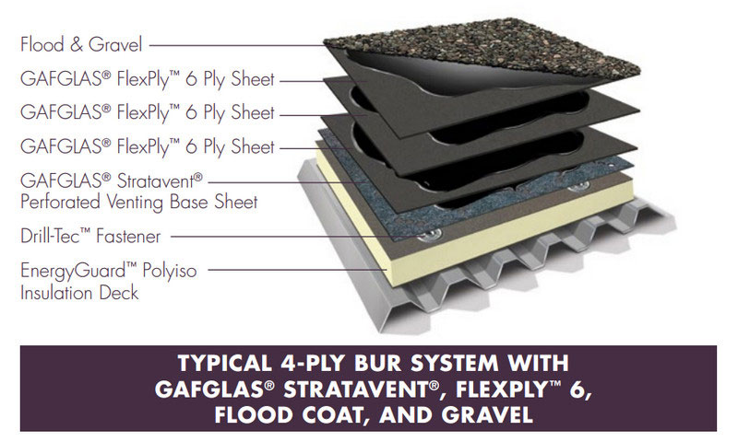
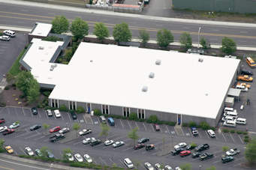
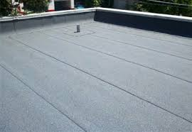
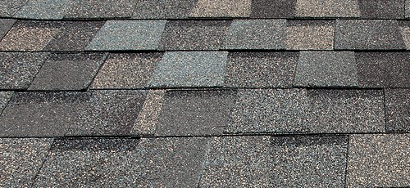
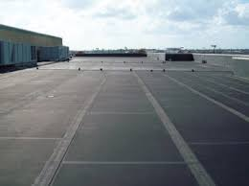
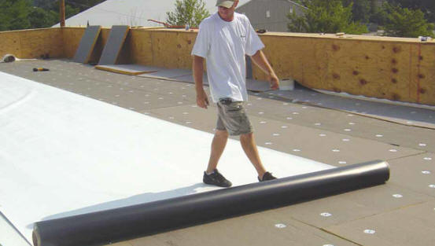
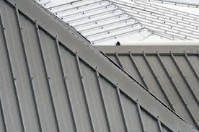
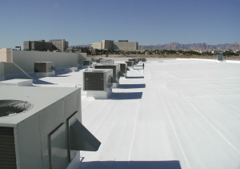
Roofing Types
PITCHED ROOFS
Composition 3 tab
PVC
Poly vinyl chloride
(Heat-welded seams)
FLAT OR ROOFS
WITH LOW PITCH
Built up with composition roll cap
Composition
Architectural
Roof Coatings
Silicone-based
GE Enduris 3500
TPO
Thermoplastic Polyolefin
Plastic/rubber with filler
(Heat-welded seams)
EPDM Ethylene Propylene
Diene Monomer
(Glued seams)
Metal

Slide 13
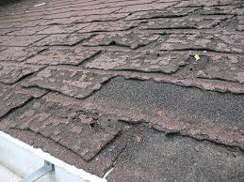
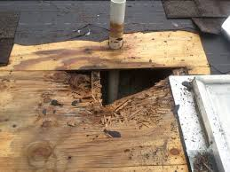
Roofing Variables
Roof life expectancy and influences
Type of material
Weather
Pitch
Age
Facing direction
Location of insulation
Energy code compliance
Full rip off vs. cover
Asbestos concerns on older schools
Energy code requirements
Number of existing layers
Alternate options to extend existing systems
Roof coatings
Must have suitable decking and structure
Cost of delaying
Mold
Compromised decking
Structural Failure

Slide 14
Roofing Cost and Pricing Variables
Pitched Roof |  | Flat Roof
3 Tab | $3-$7 | PVC/TPO/EPDM | $3-$7
Architectural | $3.50 - $7 | SBS Built up | $3.50-$8
Metal | $7-$12 | Roof coating | $1.50-$2.50
Adders and other pricing considerations
that influence total cost
Number of roof layers
Stripping off old roof vs. cover
Decking and structural repairs
Insulation requirements type/location
Material type (cap)
Method of attachment
Roof penetrations
Warranty
For this presentation the following
standard costs are used:
All sloped comp roofs $4.50 sqft.
Flat roofs @ $6.50 sqft.
Metal roofs @ $10.50 sqft.
Roof coating @ $2.25 sqft.

Slide 15
WPS School Statistics
Site 7.91 acres (1 lot)
Building area 1.30 acres
Field adjacent to school 1.44 acres (2 lots)
Original construction 1971-72,
42,743 sqft. (As Middle School)
Addition 1992-93 adds 13,643 sqft. (current K-wing)
Total sqft. 56,386
Classrooms 21/2
10 classrooms K-wing
11 Classrooms 1st grade wing
2 art/music studios (locker room conversion)
Parking 83 spaces, 3 ADA, no designated bus parking
64 staff, 334 students
Home of Kit the Beaver

Slide 16
WPS Historical Look
1992 Addition
Adds 10 classrooms
K-WING
1982 Locker room expansion, covered play area
ART/MUSIC
CVR
PLAY
GYM
1st GRADE WING
1972 Initial construction
11 classrooms, gym, music
café

Slide 17
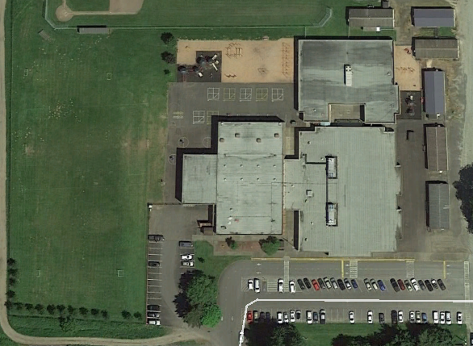
WPS Roofing and Blacktop Plan
4
A
Roofing
1 Covered play structure
2 Gym, café & mezzanine
3 1st grade wing
4 K-wing
Blacktop
A Recess area
B Field Parking
C Main parking
D Portable aprons
1
2
3
D
B
C

Slide 18
WPS
Roofing Analysis
Name /Area | Sqft. | Current Type | Grade | Remaining Life | Cost of Repair | Note
Covered play area | 3,500 | Built up Comp. cap | D | 2024 | $22,750 | Full rip off, TPO recover
Gym/cafeteria | 15,650 | Built up Comp. cap | D- | Coat 2018 | $37,460 | Excellent coating candidate
1st grade wing | 25,380 | Built up Comp. cap | D | Coat 2020 | $57,105 | Excellent coating candidate
K-wing | 16,250 | Built up Comp cap | C | Coat 2026 | $36,562 | Excellent coating candidate
A | New condition | B | Near new condition 75% | C | Mid life span 50% | D | Moderate repairs 25% | F | Imminent failure, replace

Slide 19
WPS
Blacktop Analysis
Name /Area | Sqft. | Current Type | Grade | *Cost of Repair sqft. | Extend Cost | Note
Playground area | 22,000 | Blacktop | D | .36 | $7,920 | Sealcoat 2018/2023
West parking | 11,000 | Blacktop | A | .36 | $3,960 | Sealcoat/stripe/repaired 2022/2027
Main parking lot | 34,000 | Blacktop | C | .36 | $12,240 | Sealcoat/stripe/repaired 2019/2024
Portable approach | 10,500 | Blacktop | D | .36 | $3,780 | Seal coat/stripe/repaired 2020/2025
A | New condition | B | Near new condition slight but even wear | C | Worn light cracking | D | Course W/multiple cracks water damage | F | Imminent failure, replace

Slide 20
WPS Flooring
Room Area | Material | Condition | RPL Cost | Room Area | Material | Condition | RPL Cost | Room Area | Materal | Condition | RPL Cost
Old music | VCT | C 22-25 | 3,500 | 103 | Carpet | A >10 year |  | 202 | VCT Carpet | B/C 26/25 | 5,000
Cafe | VCT | C 22-25 | 3,500 | 104 | Carpet | A >10 year |  | 203 | VCT Carpet | B/C 26/25 | 5,000
Gym | Plastic | A >10 year |  | 105 | Carpet | A >10 year |  | 204 | VCT Carpet | B/C 26/25 | 5,000
Kitchen | Epoxy | C 22-25 | 5,000 | 106 | Carpet | A >10 year |  | 205 | VCT Carpet | B/C 26/25 | 5,000
Art/music | Carpet | C 22-25 | 5,000 | 107 | Carpet | A >10 year |  | 206 | VCT Carpet | B/A >26
Lobby | VCT | D- 18-21 | 3,500 | 108 | Carpet | A >10 year |  | 207 | VCT Carpet | B/A >26
Office | Carpet | A >10 year |  | 109 | Carpet | A >10 year |  | 208 | VCT Carpet | B/C 26/25 | 5,000
Library | Carpet | A >10 year |  | 110 | Carpet | A >10 year |  | 209 | VCT Carpet | B/C 26/25 | 5,000
101 | Carpet | A >10 year |  | 111 | Carpet | A >10 year |  | 210 | VCT Carpet | B/C 26/25 | 5,000
102 | Carpet | A >10 year |  | Office | Carpet | A >10 year |  | Hall | VCT | B 26-27 | 12,000
 |  |  |  | 201 | VCT Carpet | B/C 26/25 | 5,000 | Comm | Carpet | A >10 year
A | New or like new > 10 years Life | B | Slight even wear replace estimated 26-27 | C | Worn evenly no damage, replace Estimated 22-25 | D | Perm. stain, minor de-lamination seam damage replace 18-21 | F | Extensive damage replace immediately

Slide 21
WPS HVAC
Conference room electric A/C roof top package unit. Replacement needed 35+ years old $15,000.
Two 40 ton gas electric air handling rooftop units, 25+ years old, near the end of normal service life, but still in good operating condition. Estimated cost to upgrade $15,000.
K-wing air handler A/C system with individual room VAV units, with resistance electric heaters. 25+ years, near end of normal service life, but still in good operating condition >10.
Gym side of building had new boilers installed 5 years ago. Boilers are connected to the original 1970’s air handling units. The original air handling units should continue to be serviced and repaired with no complete replacements needed within 10 years.
Roof exhaust fans, welded seams failing on numerous locations, will replace with roof work $7,500.
Entire school had a HVAC control system upgrade 5 years ago, NCC.
Art/Music room, install split systems @ $7500 each.

Slide 22
WPS Structural and Exterior/Interior Finishes
Wood stringers in parapet, selective replacement with T1-11 siding $6,500 – 2023
Open seams in exterior masonry - clean, repair, seal ,$12,500 - 2019
Replace ceiling tiles in selective areas damaged by roof leaks, $7500 – 2018 (safety)
Entire exterior of campus painted 2016/2017

Slide 23
WPS Utilities
Water /Plumbing
Dedicated drinking water line $15,000 - 2019
Replace balance of galvanized piping 1st grade wing $25,000 -2021
Large section of piping replaced at Christmas 2017 with Wirsbo-PEX,
Fire Systems
Original construction no fire sprinklers $150,000 –grant candidate
K-wing full sprinklers
Electrical
Panel locks/covers and remote switching $3,500 - 2018
Switchboard, panel labeling and schedules $2,500 - 2018
Switchboard and panel cleaning/ torqueing/lubrication and testing $2,500 - 2018
Breaker coordination study/ load survey $2,500 -2019
Natural Gas
Leak detect, isolation boiler room, $8,500 -2019

Slide 24
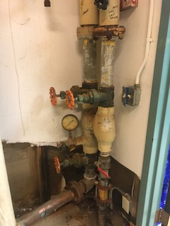
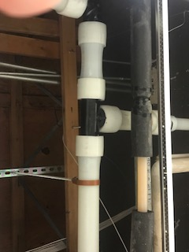
WPS Utilities

Slide 25
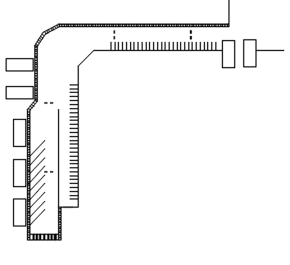
WPS Grounds Overview
Bus, Bike, Student and Pedestrian
Safety Corridor
Install 900 linear feet sidewalk
62,000 sqft. blacktop
Install speed bumps
Bus parking area
60 parking stalls
2 Pedestrian crosswalks
Designated bike Lane
**Estimated $145,000
Working in partnership with COW
acquiring grants and cost split
** Not in school cost sheet, preliminary cost estimate,
not hard quoted

Slide 26
WPS -Portable Buildings
2018 | 2019 | 2020 | 2021 | 2022 | 2023 | 2024
36k | 23k | 10k | 16k | 18k | 10k | 4k
Port. Bldg. | Use | Roof | Side | Ramp | Flooring | Interior Finishes | Ext Paint | Restrooms | Roof
PO 2/3 | WCC | 3 Tab | A | 2019 $5,000 | 2023 $7,000 | 2023 $3,000 | 2024 $1000 | - | 2019 8000
PO 4/5 | Storage | RPL | A | 2018 $5,000 | 2020 $7,000 | 2020 $3,000 | 2024 $1000 | - | -
PO 6/7 | Comm. out reach | Metal | A | 2018 $5,000 | 2022 $7,000 | 2022 $3,000 | 2024 $1000 | - | Metal
PO 8/9 | ECAP- LCC | 3 tab New | A | New | 2019 $7,000 | 2019 $3,000 | 2024 $1000 | - | -
PO 10/11 ** | Storage LCC | Metal | F | 2018 $5,000 | 2018 $7,000 | 2018 $3,000 | 2018 $1000 | 2018 $10,000 | Metal
PO 12/13 | ECAP Head start | 3 tab | C | 2021 $5,000 | 2021 $7,000 | 2021 $3,000 | 2021 $1000 | - | 2022 $8,000
PO 14 Non-District | CO-OP Preschool | - | - | - | - | - | - | - | -
** High cost in 2018 attributed to ground up rebuild of P10/11 for expanded preschool program $26k.
Total cost for this slide $112k.

Slide 27
WPS 120 month Facilities plan
6 month | 1 year 2018 | 2 year 2019 | 3 year 2020 | 4 year 2021 | 5 year 2022 | 6 year 2023 | 7 year 2024 | 8 year 2025 | 9 year 2026 | 10 year 2027
Roof | $37,460 |  | $57,105 | - | - | - | $22,750 | $57,105 | - | -
Blacktop | $7,920 | $12,240 | $3,780 | - | $3,960 | $7,920 | $12,240 | $3,780 | - | $3960
Flooring | $3,500 | - | - | - | $15,000 | $15,000 | $15,000 | $5,000 | $7,000 | -
HVAC | $7,500 | $15,000 |  | $15,000 | $15,000
Structural /Exterior | $7,500 | $12,500 |  |  |  | $6,500
Utilities | $17,500 | $26,000 | $150,000-G | $25,000
**Grounds | $145,000-G
Portables | $36,000 | $23,000 | $10,000 | $16,000 | $18,000 | $10,000 | $4,000
Total WPS (WO grant$$) | $122,380 | $88,740 | $70,885 | $56,000 | $51,960 | $39,420 | $53,990 | $65,885 | $7,000 | $3,960

Slide 28
WIS School Statistics
Site 10.68 acres (3 lots)
Building footprint approximately 1 acre (.97)
Main school parcel 218,671 sqft. (5.02 acres)
Sports field 236,095 sqft. (5.41 acres)
Acquired property 10,000 sqft. (.25 acres)
Original construction 1997/1998
Classrooms
22 classrooms
1 Resource room (currently SPED classroom)
1 Music room
Parking - 91 car, 5 ADA, 15 Bus
Current staff 497 students 71 staff
Home of the
Eagles

Slide 29
WIS Historical Look
1997/1998
Initial construction
2017 Two Portables Installed August 2017

Slide 30
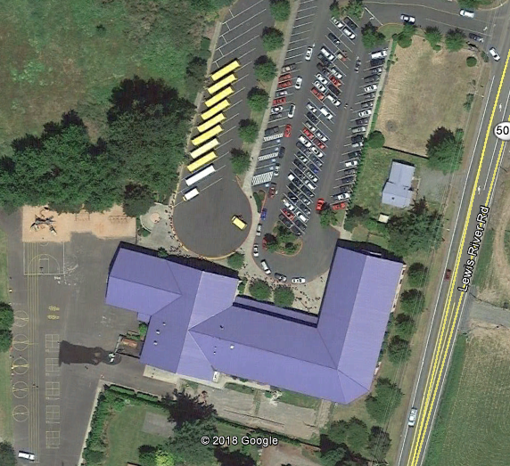
WIS Roofing and Blacktop Plan
WIS ROOFING MAP
Covered play area
Gym
Classroom wing south
Classroom wing north
Entry canopy
BLACKTOP MAP
A Bus/main parking lot
B Playground and walking path
A
A
1
2
4
B
5
3

Slide 31
WIS Roofing
Name /Area | Sqft. | Current Type | Grade | Remaining life | Replace Cost | Notes
Covered Play Area | 4,764 | Metal | B | >10 years | N/A
Gym | 12,870 | Metal | B | >10 years | N/A
Classroom Wing South | 10,472 | Metal | B | >10 years | N/A
Classroom Wing North | 16,588 | Metal | B | >10 years | N/A
Entrance Awning | 1,501 | Metal | B | >10 years | N/A

Slide 32
WIS Blacktop Analysis
Name /Area | Sq/ft | Current Type | Grade | Cost of Repair sqft | Extended Cost | Note
Main parking lot | 63,500 | Blacktop | A | .36 | $22,860 | Seal coated 2017 Sealcoat /stripe/repair 2022/2027
Playground | 46,500 | Blacktop | D | .36 | $16,740 | Sealcoat 2019/2024
A | New condition | B | Near new condition slight but even wear | C | Worn light cracking | D | Course W/multiple cracks/ water damage | F | Imminent failure, replace

Slide 33
WIS Flooring
Room Area | Material | Condition | RPL < | Room Area | Material | Condition | RPL Cost | Room Area | Material | Condition | RPL Cost
Kitchen | Tile | A | >10 year | 103 | Carpet | B | 26-27 | 205 | Carpet | C | 22-25
Gym | Rubberized | B | 26-27 | 104 | Carpet | C | 22-25 | 206 | Carpet | C | 22-25
Restrooms | Tile | A | >10 year | 105 | Carpet | D | 18-21 | 207 | Carpet | C | 22-25
Music | Carpet | D | 18-21 | 106 | Carpet | D | 18-21 | 208 | Carpet | B | 26-27
Hallway | VCT Tile | B | 26-27 | 107 | Carpet | B | 26-27 | 210 | Carpet | D | 18-21
SPED | Carpet | C | 21-24 | 109 | Carpet | B | 26-27 | 211 | Carpet | C | 22-25
Sm OFF | Carpet | B | 26-27 | 113 | Carpet | C | 22-25 | 212 | Carpet | C | 22-25
Staff BRK | Carpet | C | 22-25 | 200 | Carpet | D | 18-21 | 213 | Carpet | C | 22-25
Comp Lab | Carpet | B | 26-27 | 201 | Carpet | A | >10 year | 214 | Carpet | C | 22-25
Library | Carpet | B | 26-27 | 202 | Carpet | B | 26-27
101 | Carpet | B | 26-27 | 203 | Carpet | B | 26-27
102 | Carpet | B | 26-27 | 204 | Carpet | C | 22-25
A | New or like new > 10 years Life | B | Slight even wear replace estimated 26-27 | C | Worn evenly no damage replace Estimated 22-25 | D | Perm. stain, minor de-lamination seam damage replace 18-21 | F | Extensive damage replace immediately

Slide 34
WIS HVAC
HVAC control system is obsolete and new replacement parts are unavailable. This system should be replaced as soon as possible. Estimated cost to replace 175K.
This is a two story school without A/C in the classrooms. The school gets uncomfortably hot in the early and late part of the school year. The current boilers and air handling units are original to the school and are nearing the end of the normal service life.
It’s recommended to replace the boilers, air handling units and add a chiller for building air conditioning.
Estimated cost for entire HVAC system upgrade 1.6 million. Expected to be part of future school expansion bond.

Slide 35
WIS Structural and Exterior Finishes
Masonry block and stucco.
No major cost expected next 10 years.

Slide 36
WIS Utility Overview
Water /plumbing
Copper, post lead
Install PEX drinking water line $25,000 2019
Fire Systems
Wet/dry full building
On routine testing cycle
Electrical
All panels appropriately secured
Panel schedules in place
Need switchboard cleaning/lubrication/inspection $3500 2018
Gas
Kitchen equipment
4 hot water boilers
2 commercial hot water heaters
1 Reznor MAU (kitchen MAU)

Slide 37
WIS Grounds
Irrigation tank and distribution, – $15,000 2019
Grade and landscape lot - $2,500 2018

Slide 38
WIS Portable Buildings
Two portables installed August 2017
Each building 1736 Sqft. each
Initially constructed 2014, purchased used from Federal Way HS
Retrofitted with bathrooms prior to delivery
Exteriors painted prior to delivery, Paint 2025 ($2500)
New carpeting installed at delivery > 10 years
25 year roofing on each building >10years
Interior finishes like new at installation
No major cost expected within 10 years, other than routine preventive maintenance

Slide 39
WIS 120 month maintenance plan
*1.6 million for HVAC upgrade to existing building
and 3 million for 12,000 sqft expansion. 8 classroom
@ $250 sqft
6 month | 1 year 2018 | 2 year 2019 | 3 year 2020 | 4 year 2021 | 5 year 2022 | 6 year 2023 | 7 year 2024 | 8 year 2025 | 9 year 2026 | 10 year 2027
Roof
Blacktop |  | $16,740 |  |  | $22,860 |  | $16,740 |  |  | $22,860
Flooring | $10,000 | $5,000 | $10,000 |  | $15,000 | $15,000 | $15,000 | $15,000 | $30,000 | $35,000
HVAC |  |  |  | *$1,600,000-B
Structural /Exterior |  |  |  | *3,000,000-B
Utilities | $3,500 | $25,000
Grounds | $2,500 | $15,000
Portables |  |  |  |  |  |  | $3,500
Total WIS (WO grant/bond) | $16,000 | $61,740 | $10,000 |  | $37,860 | $15,000 | $35,240 | $15,000 | $30,000 | $57,860

Slide 40
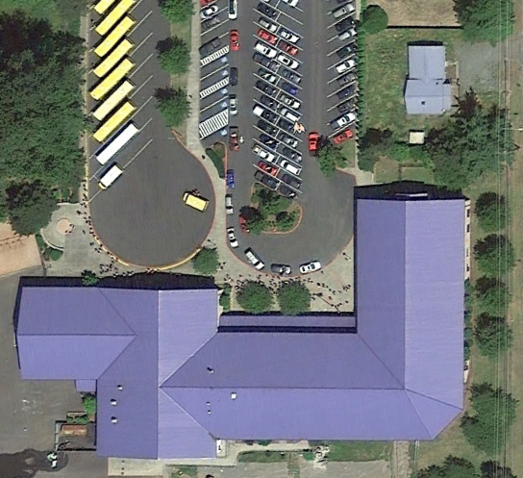
WIS Expansion Opportunities
Acquired property
2280 Lewis River Road, directly
to the north of the school north wing
House demolished December 2017
Property sqft. 11,000 (.3 acre)

Slide 41
Woodland Middle School
Home of the Trojans

Slide 42
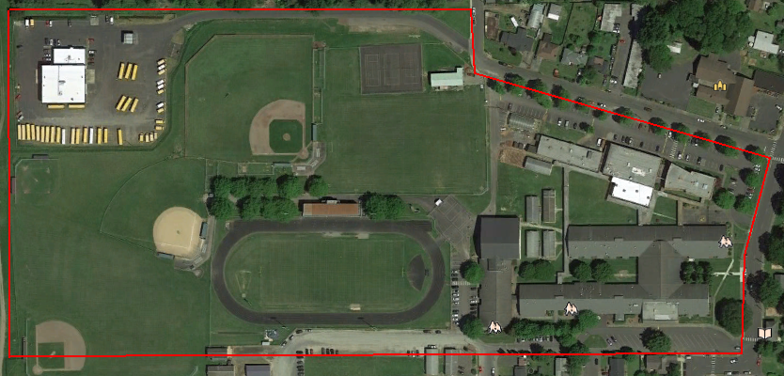
WMS School Statistics
Site 33.46 acres 2 parcels
Buildings 3.02 acres
Original construction (current site layout)
1951/1953/1962/1964/1966/1967/1982/1993
Classrooms 33/35 (teachers lounge
consumes 2 rooms)
Gross sqft. 132,000
Parking 138 auto, 5 ADA 18 bus
Students 724, staff 74

Slide 43
WMS Historical Look
Originally constructed as Primary School in 1951
Commons and classroom addition 1953/54 as part of WHS construction
Yellow Hall addition 1962
Green Hall extension 1964
Classroom addition (2) 1967
Gym locker room 1982
Yellow Gym, Library addition and building modernization 1993

Slide 44
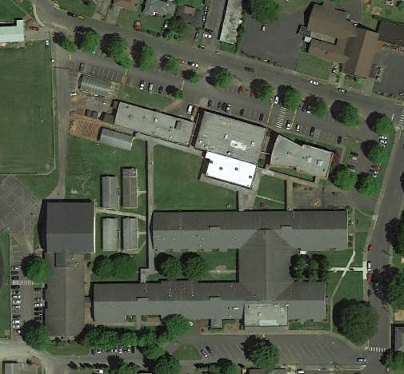
WMS Roofing Map
WMS ROOFING MAP
Yellow Gym
Yellow Hall west
Yellow Hall main
Commons
Library bridge
Green Hall
Metal Shop
Green Gym
Green Mezzanine
Performing Arts
BLACKTOP
A North/Green Gym parking
B West parking, BB court, service road
C Bus parking, DO south
A
7
8
10
9
B
1
6
5
2
3
4
C

Slide 45
WMS Roofing Analysis
Name /Area | Sq/ft | Type | Grade | Replace-ment | Cost | Note
Yellow Gym | 10,780 | Metal | C | >10 years | -
Yellow Hall west end | 15,325 | Composition S | A/C | 2021 | N/A -$34,481
Yellow Hall main | 37,571 | Composition S | A/C | 2023 | N/A- $84,535
Commons | 3,950 | Comp B/U | D- | 2020 | $25,675
Library | 8,950 | Composition S | A/C | >10/2026 | $20,137
Green Hall | 36,050 | Composition S | A/C | >10/2027 | N/A-$81,112
Metal Shop | 7,700 | Comp B/U | D | 2024 | $17,325 | Possible coating
Green Gym | 10,150 | Comp B/U | F | 2018 | $65,975 | Tear off
Green Mezz | 5,000 | TPO | A | >10 years | -
Performing Arts | 6,720 | Comp B/U | D | 2019 | $15,120 | Possible coating

Slide 46
WMS Blacktop Analysis
Name /Area | Sqft. | Current Type | Grade | Cost Sqft. | Extended cost | Note
North parking lot | 51,500 | Blacktop | D | .36 | $18,540 | Sealcoat/stripe/repaired 2019/2025
Playground, west parking, service rd. | 33,000 | Blacktop | C | .36 | $11,880 | Sealcoat/stripe/repaired 2020/2026
Commons and DO parking | 36,530 | Blacktop | C | .36 | $13,150 | Sealcoat/stripe/repaired 2021/2027
A | New condition | B | Near new condition slight but even wear | C | Worn light cracking | D | Course W/multiple cracks water damage | F | Imminent Failure, replace

Slide 47
WMS Flooring
A | New or like new > 10 years Life | B | Slight even wear replace estimated 26-27 | C | Worn evenly no damage replace Estimated 22-25 | D | Perm. stain, minor delamination seam damage replace 18-21 | F | Extensive damage replace immediately
Yellow West |  |  |  | Yellow East |  |  |  | Green Hall
Room/Area | Material | Cond. | REPL | Rm/Area | Material | Cond |  | Room/Area | Material | Cond | Condition
313 | Carpet new | A | >10 yr | 449 | Carpet new | A | >10 yr. | 413 | Carpet new | A | >10 yr.
325 | Carpet new | A | >10 yr | 450 | Carpet new | A | >10 yr. | 415 | Carpet new | A | >10 yr.
LRA | Carpet tiles | B | 26-27 | 317 | Carpet new | A | >10 yr. | WMS Office | Carpet tiles | B | 26-27
Lkr Room | Epoxy | B | 26-27 | 314 | Carpet new | A | >10 yr. | 421 | Carpet new | A | >10 yr.
307 | Carpet new | A | >10 yr | 323 | Carpet old | B | 26-27 | 423 | Carpet new | A | >10 yr.
308 | Carpet new | A | >10 yr | 326 | Carpet old | D | 18-21 | 427 | Carpet new | A | >10 yr.
305 | Carpet old | D | 18-21 | 447 | Carpet old | D | 22-25 | 429 | Carpet new | A | >10 yr.
306 | Carpet old | D | 18-21 | 448 | Carpet old | D | 18-21 | 412 | Carpet old | D | 18-21
311 | Carpet old | C | 22-25 | 319 | Carpet old | D | 18-21 | 417 | Carpet old | C | 22-25
312 | Carpet old | C | 22-25 | 320 | Carpet old | B | 26-27 | 424 | Carpet old | B | 26-27
DO | Carpet old | D | 18-21 | Kitchen | Epoxy | B | 26-27 | 425 | Carpet old | B | 26-27
Main hall | Carpet old | C | 22-25 | 318 | VCT tile | B | 26-27 | 419 | Epoxy | C | 22-25
324 | Carpet old | D | 18-21 | Commons | VCT tile | B | 26-27 | 428 | VCT tile | A | >10 yr.
Gym hall | VCT tile | B | 26-27 | S. Commons | VCT tile | B | 26-27 | 426 | VCT tile | A | >10 yr.
Bathrooms | Tile | A | >10 | Comm hallway | VCT tile | B | 26-27 | 430 | VCT tile | B | 26-27
315 | VCT tile | B | 26-27 | Gym | Wood | B | >10yr. | 431 | VCT tile | B | 26-27
316 | VCT tile | B | 26-27 | Library | Carpet new | A | >10 yr. | 432 | VCT tile | A | >10 yr.
Yellow Gym | Wood | B | >10 yr | Yellow hall | Carpet | C | 22.25 | Green hall | VCT tile | F/A/B | 2018

Slide 48
WMS HVAC
Computer server room A/C unit. The current A/C system is 23+ years old and is too small for the amount of heat generated by the number of installed computer equipment. Needs new larger system. Recommend adding a ductless A/C split system. 10K
LRA, District Office, Middle School Office, computer lab and science classrooms all have split heat pump units with air handlers that are beyond their normal service life 23+ years old, these will need to be replaced over the next 10 years as parts become unavailable. Estimated cost of project 175k.
Classroom furnaces. Each classroom and common hallway areas are heated by a residential style gas furnace. These gas furnaces are 23+ years old and many of the parts are no longer available. Furnaces will need to be replaced when parts fail. Estimated cost per furnace to replace 5K.
Gym and auditorium had new boilers installed this year. These boilers are connected to old air handling units that should continue to be serviced and repaired with no replacements needed anytime soon.
Entire school had a HVAC control system upgrade 5 years ago.

Slide 49
WMS Structural Interior and Exterior Finishes
Mortar repair and seal brick $25,000 - 2019
Exterior painting and sealing – $25,000 – 2018-2021 (in house cost)
Ceiling tiles Green Gym (safety concern) $8500-2018
Floor leveling and coating covered lunch area, $8500-2019
Pass through hallway green/yellow halls $25,000-2021
Sidewalk to Green Gym from Green Hall west $14,000-2018

Slide 50
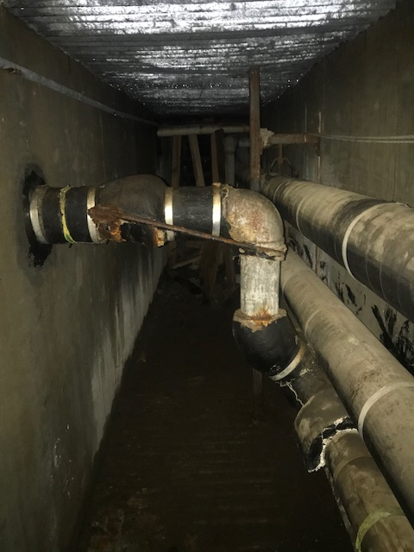
WMS Utility Overview
Water
Replace galvanized lines to gym and shop complex (service life expired) 2019 (25k)
Install dedicated fountain service line 2018 (25k)
Electrical
Install exterior LED lighting in covered play area 7.5k -2022
Complete main switchboard maint. $4500 2018
Repair broken panels and add exterior switching $4,500 - 2019
GAS
Install gas leak detection and isolation system 2019 $25,000
Fire safety
Clean up/map Simplex wiring 2018 $5000
22

Slide 51
WMS Grounds
Item | Cost | When
Remove balance of pin oaks install new trees Buckeye St – undermining sidewalk and blacktop | $7,500 | 2018
Landscaping improvement entire campus | $7,500 | 2018
Well distribution storage tanks and distribution | $7,500 | 2019
Building gutter replacement | $17,325 | 2019
Covered walkway gutter replacement | $17,100 | 2019
Drywell drain line clearing | $4,500 | 2020

Slide 52
WMS Portable Buildings
Port. Bldg. | Use | Roof | Side | Ramp | Flooring | Interior Finishes | Restroom | Cost /Notes
462 463 | FAC/Train ELL | C 2022 | New 2016 | New 2016 | New A New A | B B | No No | Roof 8K 2022
464 465 | GRN Rm Storage | D 2020 | New 2016 | New 2016 | VCT D VCT D | D D | No No | Flooring 2021-7k Roof 2020-8k Interior 2023-3k
466 467 | Training SS | C 2021 | New 2016 | New 2016 | Carpet C Carpet C | C C | No No | flooring 2022-7k Roof, 2021 -8k
468 469 | Music Testing | C 2022 | New 2016 | New 2016 | Carpet D Carpet B | B B | No No | Flooring 2020 – 7k Roof 2022 – 8k
470 471 | Comp lab Comp lab | D 2019 | New 2016 | Wood C | Carpet B Carpet B | B B | No No | Ramp 2019-5k Carpet 2026-7k Roof 2019 -8k
462

Slide 53
WMS 120 month maintenance plan
6 month | 1 year 2018 | 2 year 2019 | 3 year 2020 | 4 year 2021 | 5 year 2022 | 6 year 2023 | 7 year 2024 | 8 year 2025 | 9 year 2026 | 10 year 2027
Roof | $65,975 | $15,120 | $25,675 | $34,481 |  | $84,575 | $17,325 |  | $20,137 | $81,112
Blacktop |  | $18,540 | $11,880 | $13,150 |  |  |  | $18,540 | $11,880 | $13,150
Flooring | $12,500 | $12,500 | $12,500 | $12,500 | $7,500 | $7,500 | $7,500 | $7,500 | $47,500 | $47,500
HVAC |  | $10,000 | $15,000 | $43,750 | $15,000 | $43,750 | $15,000 | $43,750 | $15,000 | $43,750
Structural /Exterior | $18,500 | $43,500 | $10,000 | $25,000
Utilities | $34,500 | $49,500 |  |  | $7,500
Grounds | $15,000 | $41,925 | $4,500
Portables |  | $13,000 | $15,000 | $15,000 | $23,000 | $3,000 | - | - | $7,000
Total WMS (WO grant/bond) | $146,475 | $204,085 | $95,555 | $143,881 | $53,000 | $138,825 | $39,825 | $69,790 | $101,517 | $185,512

Slide 54
Woodland High School
Home of the Beavers

Slide 55
WHS Statistics
Site 40.88 acres (2 parcels)
Building footprint approximately 2.64 acres (.97)
153,000 gross sqft
Original construction 2013/14
Parking – 414 car 10 ADA, 14 bus with auto shadow lines (46 auto)
Current staff 734 students 64 staff
Classrooms
18 Regular classrooms
6 Science labs
3 Computer /IT lab
1 Culinary
2 Business lab
1 Horticulture
1 Music room
2 Resource
1 Life Skills (currently SPED classroom)
1 Music room
1 Career center
2 Art rooms

Slide 56
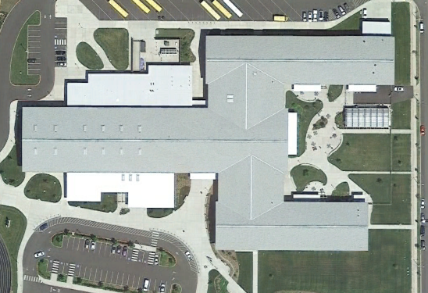
WHS Historical Look
Bond levy passed 2012
Construction began 2013
Construction ends 2015
First class 2015

Slide 57
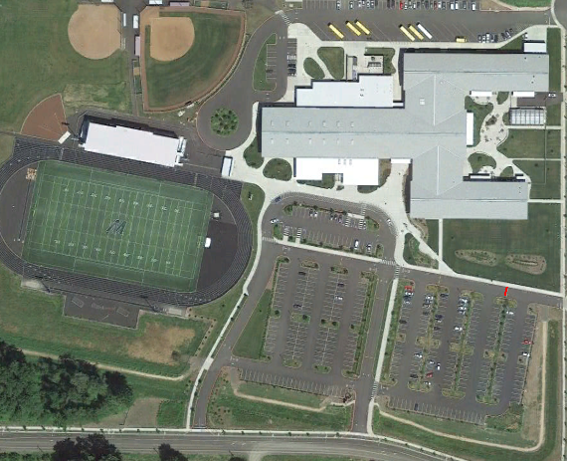
WHS Roof and
Blacktop Map
A
B
5
2
6
Stadium
Locker room
Gym
Spin/weight Room
Classroom wing north
Classroom bridge north
Classroom bridge south
Classroom wing south
Entrance awnings (7 installations)
A North parking
B Sport fields and approaches
C Gym and exit rd.
D Main Parking west
E Main parking east
3
9
1
4
7
8
1
C
D
E
C

Slide 58
WHS
ROOFING ANALYSIS
Name /Area | Sqft. | Type | Grade (key below) | Remaining Life | Cost (NA if past 10 years) | Expect Replacement Date | Note
Stadium | 11,700 | Metal | A | 92.5% | N/A | 30-50 year (40)
Locker Room | 10,250 | Metal | A | 92.5% | N/A | 30-50 year (40)
Gym | 49,675 | Composition | A | 92.5% | N/A | 22 year
Spin/Weight Room | 7,000 | Metal | A | 92.5% | N/A | 30-50 year (40)
Classroom Wing North | 26,426 | Composition | A | 88% | N/A | 22 year
Classroom Bridge North | 5,720 | Composition | A | 88% | N/A | 22 year
Classroom Bridge South | 6,435 | Composition | A | 88% | N/A | 22 year
Classroom wing South | 21,450 | Composition | A | 88% | N/A | 22 year
Entrance Awnings | 1,800 | Metal | A | 92.5% | N/A | 30-50 year (40)
A | New condition | B | Near new condition 75% | C | Mid life span 50% | D | Requires moderate repairs 25% | F | Imminent failure, in need of replacement

Slide 59
WHS Blacktop Analysis
Name /Area | Sqft. | Current Type | Grade | Cost of Repair sqft. | Extended Cost | Note
North parking lot | 89,785 | Blacktop | A | .36 | $32,322 | Sealcoat/stripe/repaired 2020/2025
Sports field and stadium approaches service rds. | 40,500 | Blacktop | A | .36 | $14,580 | Sealcoat/stripe/repaired 2023/2028
Gym parking and exit road | 82,500 | Blacktop | A | .36 | $29,700 | Sealcoat/stripe/repair 2022/2027
Main parking west and entrance rd. | 62,000 | Blacktop | A | .36 | $22,320 | Sealcoat/stripe/repair 2021/2026
Main parking east | 64,980 | Blacktop | A | .36 | $23,392 | Sealcoat/stripe/repair 2021/2026

Slide 60
WHS Flooring
All Flooring >10 years

Slide 61
WHS HVAC
Two Fulton high efficiency boilers
Multiple HW/CW air handlers
Multiple MAU with heat recovery
No major maintenance expected within 10 years other than routine preventive maintenance.

Slide 62
WHS Structural and Exterior
Built to seismic design category D (high seismic vulnerability)
No structural cost expected within 10 years
Seismic Design Category (SDC) | Definition
A | Very small seismic vulnerability
B | Low to moderate seismic vulnerability
C | Moderate seismic vulnerability
D | High seismic vulnerability
E&F | Very high seismic vulnerability and near major fault

Slide 63
WHS Utilities
Electrical
12.5KW Solar facility install 2018/2027-$10,000
GAS
Install gas leak detection and isolation system 2019-$6,000
Fire Safety
Fully sprinklered interior wet system, exterior dry system

Slide 64
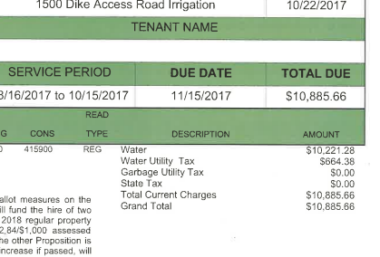
WHS Grounds
Install well storage and distribution system 35k
Apply for water rights

Slide 65
WHS 120 Month Plan
6 month | 2018 | 2019 | 2020 | 2021 | 2022 | 2023 | 2024 | 2025 | 2026 | 2027
Blacktop | - | - | $32,322 | $46,118 | $29,700 | $14,580 | - | $32,322 | $46,718 | $29,700
Roof | - | - | - | - | - | - | - | - | - | -
Flooring | - | - | - | - | - | - | - | - | - | -
HVAC | - | - | - | - | - | - | - | - | - | -
Structural/Ext. | - | - | - | - | - | - | - | - | - | -
Utilities | 10,000 | 6,000 | - | - | - | - | - | - | - | -
Grounds | - | 35,000 | - | - | - | - | - | - | - | -
Portables | - | - | - | - | - | - | - | - | - | -
Total WMS (WO grant/bond) | 10,000 | 41,000 | 32,000 | 46,118 | 29,700 | 14,580 |  | 32,322 | 46,718 | 29,700

Slide 66
Yale School
Home of the Cougars

Slide 67
Yale School Historical Look
House
Old school Location
Demolished
Current School Building
Constructed 1962
Cafeteria
and Library
Addition 1993
Gym Complete
Restoration 2014

Slide 68
Yale School School Statistics
Site 8.94 acres (2 parcels)
Building area .33 acres (School .25, Gym .08)
Original construction 1962
Addition 1993 adds library, cafeteria and hallway
Total sqft. 14,975 (school 11,000 gym 3975)
3 Classrooms
Library
Cafeteria
Parking, gravel lot. Estimated @30 spaces
7 staff 39 students

Slide 69
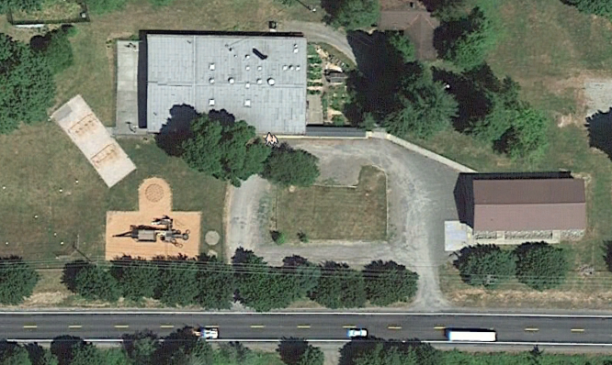
Yale School Blacktop and Roof Plan
1
Roof
1 Main school building
2 Gym roof
Blacktop
A Gravel only
A
2

Slide 70
Yale School Roof Plan & Blacktop Plan
Name /Area | Sqft. | Type | Grade (key below) | Remaining Life | Cost (NA if past 10 years) | Expected Life | Note
School | 10960 | Comp cap Built-up | D | 5% | $71,240 | 25 year | Heavy ripples may not be coated
Gym | 3800 | Metal | A | 92.5% |  | 30-50 year(40%)
Name /Area | Sqft. | Current Type | Grade | Cost of Repair sqft. | Extended Cost | Note
Parking area | 23,250 | Gravel | N/A | .15 | $2000 | Re-gravel annual

Slide 71
Yale School Flooring
Area | Material | Condition | Notes
Kitchen | VCT tile | C 7,500-2025 | Tile and adhesive possible source of asbestos
Entry and main hall | Carpet over VCT | C 5,000-2025 | Asbestos risk
Classroom 1 | Carpet over VCT | B $5,000-2027 | Asbestos risk
Classroom 2 | Carpet over VCT | B $5,000 -2027 | Asbestos risk
Classroom 3 | Carpet over VCT | B $5,000-2026 | Asbestos risk
Library | Carpet | B $5,000-2026
Cafeteria | Tile | B $5,000-2025
A | New or like new > 10 years Life | B | Slight even wear replace estimated 26-27 | C | Worn evenly no damage replace Estimated 22-25 | D | Perm. stain, minor delamination seam damage replace 18-21 | F | Extensive damage replace immediately

Slide 72
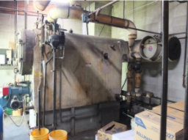
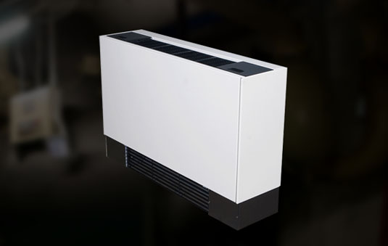
Yale School HVAC
Currently heated by 55+ year old, oil fired steam boiler. This system is currently in the planning phase for replacement, funded mostly by a State grant.
System is slated for replacement summer of 2018
Library and cafeteria are heated by 2 small oil forced-air furnaces
Semi automatic pellet boiler system backed up with propane trimming boiler.
Abandon in place existing steam boiler and piping systems
Install new hot water recirculation line throughout the building
Install new wall mounted hot water fan filter units

Slide 73
Yale School Utilities
Water
Well system and storage tank
Interior piping galvanized Steel
Add chlorination system 2018-$7,500
Add drinking water service line-2019 -$5,000
Electrical
Main switchboard cleaning and maintenance 2020-$2,500
Propane
Heating for gym area
Install gas leak detection and auto shutoff 2019 - $2,500
Fire safety
No sprinklers, install fire pump and distribution $50,000k (seek grant$$)

Slide 74
Yale School Grounds
Replace Play Structure
Existing structure build in 80’s and presents hazards (Healthy Kids grant) $25,000
Covered Walkway (120 lf) $8,000
Add 120 lf of covered walkway to existing system
Structural and Exterior
No cost within 10 years

Slide 75
Yale School 120 Month Plan
6 month | 1 year 2018 | 2 year 2019 | 3 year 2020 | 4 year 2021 | 5 year 2022 | 6 year 2023 | 7 year 2024 | 8 year 2025 | 9 year 2026 | 10 year 2027
Roof |  |  | $71,240
Blacktop
Flooring |  |  |  |  |  |  |  | 17,500 | 10,000 | 10,000
HVAC | 20,000
Structural /Exterior
Utilities | 7,500 | 7,500
Grounds | 12,500 | 8,000
Portables
Total Yale (WO grant/bond) | $39,500 | $15,500 | $71,240 |  |  |  |  | 17,500 | 10,000 | 10,000
Grant/bond $$ | 12,500 | 50,000

Slide 76
District Assets Equipment, Vehicles and Holdings
Partners In Transition (PIT) house
TEAM and BO portables
Fleet Vehicles
Grounds Equipment
District Assets 10 year plan
Consolidated 10 year plan

Slide 77
Pit House 10 year plan
 | 1 year 2018 | 2 year 2019 | 3 year 2020 | 4 year 2021 | 5 year 2022 | 6 year 2023 | 7 year 2024 | 8 year 2025 | 9 year 2026 | 10 year 2027
Roof 3 tab |  |  |  |  |  |  | $8,000
Exterior finishes |  |  | $12,500 |  |  |  |  |  |  |  | LP siding (the bad kind) & paint
Plumbing
Kitchen
Flooring
Grounds

Slide 78
Team and BO Portables Portable Plan
Port. Bldg. | Use | Roof | Siding | Ramp | Flooring | Int. Finish | Ext Paint | Rest Rooms | Cost/ Notes
Business Office | WCC | 3 Tab >10yr | A | Newer Alum | Carpet Original | A | 2025 $2500 | Yes OK | Building in good material condition. exterior painted 8/17
TEAM High | Storage | 3 Tab >10yr | A | Newer Alum | Carpet Original | A | 2025 $2500 | Yes OK | Building in good material condition. exterior painted 8/17

Slide 79
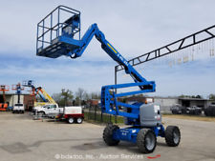
District Grounds Equipment
MFG | MDL | EQ TYPE | YEAR | LOCATION
John Deere | JDX 750 | Mower | 2015 | WMS | New for WHS
John Deere | JDX 748 | Mower | 2007 | WMS | >10 yr.
John Deere | 2032 | Tractor | 2015 | WMS | New for WHS
John Deere | JD 955 | Tractor | 1997 | WHS | >10 yr.
Kubota | ZG 222 | Mower | 2008 | WHS | >10 yr.
John Deere | JD 455 | Mower | 1995 | WIS | Replace 2023 @ $7,500
John Deere | JD 455 | Mower | 1995 | Yale | >10 yr.
Equipment | Model | Cost | Year
Field Mower | TBD | 20,000 | New
Exterior 45’ Lift | JLG or Genie DSL | $10,000 | Very Used

Slide 80
Fleet Vehicle's
Name | Year | Make | Model | Location/Use | Color | Mileage | Action | RPL | Cost
Grounds truck | 88 | Chevy | C-20 | Grounds | White | 165,033 | Sell
Grounds Truck | 1991 | Chevy | C-20 | Grounds | Red | 236,552 | Sell and replace with used 4WD LB DSL | 2019 | $15,000
HVAC Van | 2002 | Ford | Club Wagon | KWRL | White | 109,793 | Keep until no longer serviceable
Tech Van | 1989 | Chevy | Sports van | Tech | Grey | 46,203 | Keep until no longer serviceable
White van | 1986 | Ford | Club Wagon | Maintenance | White | 66,899 | Keep until no longer serviceable
Maintenance truck | 2006 | Chevy | Silverado | Maintenance | White | 112,711 | Keep until no longer serviceable
Pit 2 | 2004 | Chrysler | T&C | Pit /BO | Silver | 136,494 |  | 2022
E11 | 2015 | Chevy | Express | WHS | White | 26,810 |  | 2026 | $28,000
E12 | 2015 | Chevy | Express | WHS | White | 23,153 |  | 2027 | $28,000
E13 | 2015 | Chevy | Express | WHS | White | 14,399 |  | 2028 | $28,000
Suburban | 2004 | Chevy | Suburban | WHS |  | 130,557 | Replace with used 8 passenger Van | 2021 | 15,000
Mini 1 | 2007 | Dodge | Caravan | WHS | Bl/Gr | 96,116
Mini 2 | 2006 | Dodge | Caravan | WHS | Lt Blue | 113426

Slide 81
District Summary 120 Month Plan
6 month | 1 year 2018 | 2 year 2019 | 3 year 2020 | 4 year 2021 | 5 year 2022 | 6 year 2023 | 7 year 2024 | 8 year 2025 | 9 year 2026 | 10 year 2027
PIT house | - | - | $12,500 | - | - | - | $8,000 | - | - | -
TEAM and BO Portables | - | - | - | - | - | - | - | $5,000 | - | -
Grounds Equipment | - | - | - | - | $20,000 | $7,500 | - | - | - | -
Fleet Vehicles | - | $15,000 | - | $15,000 | - | - | - | - | $28,000 | $28,000
Total |  | 15,000 | 12,500 | 15,000 | 20,000 | 7500 | 8000 | 5000 | 28000 | 28000

Slide 82
District Summary 120 Month Plan
6 month | 1 year 2018 | 2 year 2019 | 3 year 2020 | 4 year 2021 | 5 year 2022 | 6 year 2023 | 7 year 2024 | 8 year 2025 | 9 year 2026 | 10 year 2027 | School Total
Woodland Primary | $122,380 | $88,740 | $70,885 | $56,000 | $51,960 | $39,420 | $53,990 | $65,885 | $7,000 | $3,960 | $560,220
Woodland Intermediate | $16,000 | $61,740 | $10,000 | - | $37,860 | $15,000 | $35,240 | $15,000 | $30,000 | $57,860 | $278,700
Woodland Middle | $146,475 | $204,085 | $95,555 | $143,881 | $53,000 | $138,825 | $39,825 | $69,790 | $101,517 | $185,512 | $1,178,465
Woodland High | $10,000 | $41,000 | $32,000 | $46,118 | $29,700 | $14,580 | - | $32,322 | $46,718 | $29,700 | $282,138
Yale School | $39,500 | $15,500 | $71,240 | - | - | - | - | $17,500 | $10,000 | $10,000 | $163,740
District Assets | - | $15,000 | $12,500 | $15,000 | $20,000 | $7,500 | $8,000 | $5,000 | $28,000 | $28,000 | $139,000
Total | $334,355 | $426,065 | $292,180 | $260,999 | $192,520 | $215,325 | $137,055 | $205,497 | $223,235 | $315,032 | $2,602,263
Total @2.5%/yr. increase | - | $472,079 | $306,206 | $280,573 | $211,722 | $242,240 | $157613 | $241,458 | $267,882 | $385,914 | $3,196,959

